Slide 1

Introduction to data science – ai & ml
roadmap

Slide 2
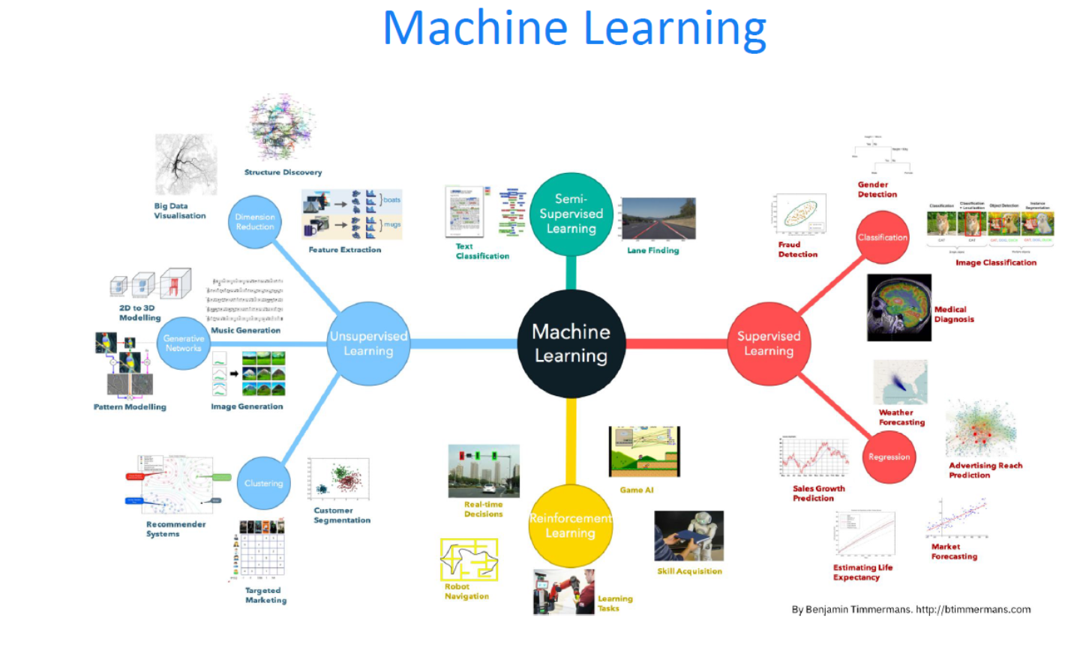

Slide 3
9 | Data Sampling Sampling techniques Weighted random sampling Priority sampling Non uniformity sampling | 6. Data Sampling Techniques T2
10 | Time series | 7. Algorithms for mass data problems
11 | Regression, Classification (supervised) Examples | 7. Algorithms for mass data problems T2
12 | Decision Trees (Rules - Rule based) Random forests Examples | 7. Algorithms for mass data problems T2
13 | Clustering Text mining Examples | 7. Algorithms for mass data problems T2
14 | Introduction to Deep Learning Introduction to Neural Nets | 7. Algorithms for mass data problems (Instructor supplied materials)
15 | Data Engineering Tools Languages (R, Python) S/w packages (SPSS, SAS etc) | 8. Tools for Data science. (Instructor supplied materials)

Slide 4
Standard Machine Learning | Applications / Use Cases
Linear Learner | Regression & Classification (Sample R/Python Code, Link to AWS Sagemaker)
Time Series Modelling | Forecasting and Time Series Anomaly Detection (Sample R/Python Code, Link to AWS Sagemaker)
Tree Based Models – Decision Trees, Random Forest , Boosted Trees/XG Boost | Random Cut Forest Anomaly Detection (Sample R/Python Code, Link to AWS Sagemaker)
K Means/Clustering & Text Mining (Simple NLP – VSM, IR & LSA) | Traditional Search Engines (Sample R/Python Code)

Slide 5
Deep Learning | Applications / Use Cases
Neural Networks – Introduction | Regression & Classification (Sample R Code)
Computer Vision Introduction using Convolutional Neural Network | MNIST & CIFAR Image Classification (Python/Tensorflow/Keras Code)
Deep Natural Language Processing – From IR to Word Embeddings | Search Engine – Indexing, Text Classification, Intelligent Automation (Python/Tensorflow/Keras Code) (Link to AWS Sagemaker)
Deep Natural Language Processing – Sequential Modelling using Recurrent Neural Networks | Language Modelling/Prediction, Search Engine – Alternate Query Suggestion & Related Search Content Text Classification (Python/Tensorflow/Keras Code)
Deep Natural Language Processing – From RNN to Convolutional Modelling | Better Text Classification (Python/Tensorflow/Keras Code)

Slide 6
Generative Deep Learning | Applications / Use Cases
From Probabilistic Modelling to Bayesian Machine Learning – Traditional HMM , EM Algorithms, Topic Modelling (LDA) | Topic Modelling for Categorizing Docs/Articles/Events/Tickets for Automation
From EM Modelling to Variational Inference Modelling – Neural Topic Modelling, VAE, GAN | Text , Music and Image Generation (Python/Tensorflow/Keras Code) (Link to AWS Sagemaker)
Deep Natural Language Processing – From RNN Classification to RNN Seq2Seq Modelling | Text Summarization (Abstractive & Extractive) Neural Machine Translation, Q&A/Dialog Systems, Chatbots
Deep Natural Language Processing – From Seq2Seq Modelling to Attention Mechanism | Advanced & Improved NLP Tasks
Deep Natural Language Processing – Transformer Architectures (Attention is all you need!!!) (ELMo, BERT Transformer) | State of the Art (SOTA) Architectures (Link to Tensor2Tensor), (Link to Sagemaker SockEye Based Seq2Seq)

Slide 7
Natural Language Processing Frameworks
NTM Model – Uses Neural Variational Inference Architecture as outlined in: https://arxiv.org/abs/1402.0030
https://github.com/awslabs/amazon-sagemaker-examples/tree/master/introduction_to_amazon_algorithms/ntm_synthetic
Text Summarization –
Uses Text Summarization with Pre-Trained Encoders as outlined in : https://arxiv.org/abs/1908.08345
https://github.com/nlpyang/BertSum
Uses Sockeye based Seq2Seq Summarization https://arxiv.org/pdf/1712.05690
https://github.com/awslabs/amazon-sagemaker-examples/tree/master/introduction_to_amazon_algorithms/seq2seq_translation_en-de
https://github.com/theamrzaki/text_summurization_abstractive_methods
Text Classification – Uses Word2Vec based Text Classification as outlined in : https://dl.acm.org/citation.cfm?id=3146354
https://github.com/awslabs/amazon-sagemaker-examples/tree/master/introduction_to_amazon_algorithms/blazingtext_word2vec_text8
Anomaly Detection and Forecasting Frameworks
Anomaly Detection Model (Random Cut Forest) – Uses Random Isolation Forest Architecture as outlined in: http://proceedings.mlr.press/v48/guha16.pdf
https://github.com/awslabs/amazon-sagemaker-examples/tree/master/introduction_to_amazon_algorithms/random_cut_forest
DeepAR Forecast Model – Uses Probabilistic Forecasting with Autoregressive Recurrent Networks as outlined in : https://arxiv.org/abs/1704.04110
https://github.com/awslabs/amazon-sagemaker-examples/tree/master/introduction_to_amazon_algorithms/deepar_synthetic
https://github.com/awslabs/amazon-sagemaker-examples/blob/master/introduction_to_amazon_algorithms/deepar_electricity/DeepAR-Electricity.ipynb

